Slide 1
DATABASE MANAGEMENT SYSTEMS
Subject Teacher: Junaid Javed Korai

Slide 2
RESTRICTING AND SORTING DATA
Lecture # 11,12
Disclaimer: The material used in this presentation to deliver the lecture i.e., definitions/text and pictures/graphs etc. does not solely belong to the author/presenter. The presenter has gathered this lecture material from various sources on web/textbooks. Following sources are especially acknowledged:
Connolly, Thomas M., and Carolyn E. Begg. Database systems: a practical approach to design, implementation, and management. Pearson Education, 2005.
Gorman,Tim, Inger Jorgensen, Melanie Caffrey, and Lex deHaan. Beginning Oracle SQL: For Oracle Database 12c.Apress, 2014.
Greenberg, Nancy, and Instructor Guide PriyaNathan. "Introduction to Oracle9i: SQL." ORACLE, USA (2001).
2

Slide 3
OBJECTIVES
After completing this lesson, you should be able to do the following:
Limit the rows retrieved by a query
Sort the rows retrieved by a query

Slide 4
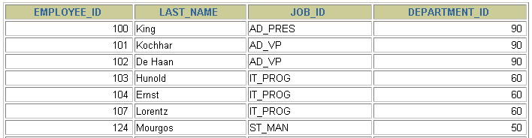

LIMITING ROWS USING A SELECTION
EMPLOYEES
…
“retrieve all employees
in department 90”

Slide 5
LIMITING THE ROWS SELECTED
Restrict the rows returned by using the WHERE clause.
SELECT *|{[DISTINCT] column|expression [alias],...}
FROM table
[WHERE condition(s)];
The WHERE clause follows the FROM clause.

Slide 6

USING THE WHERE CLAUSE
SELECT employee_id, last_name, job_id, department_id FROM employees
WHERE department_id = 90 ;

Slide 7
CHARACTER STRINGS AND DATES
Character strings and date values are enclosed in single quotation marks.
Character values are case sensitive, and date values are format sensitive.
The default date format is DD-MON-RR.
SELECT last_name, job_id, department_id
FROM employees
WHERE last_name = 'Whalen';

Slide 8
COMPARISON CONDITIONS
Operator | Meaning
= | Equal to
> | Greater than
>= | Greater than or equal to
< | Less than
<= | Less than or equal to
<> | Not equal to

Slide 9
USING COMPARISON CONDITIONS
SELECT last_name, salary FROM employees
WHERE salary <= 3000;

Slide 10
OTHER COMPARISON CONDITIONS
Operator | Meaning
BETWEEN ...AND... | Between two values (inclusive),
IN(set) | Match any of a list of values
LIKE | Match a character pattern
IS NULL | Is a null value

Slide 11
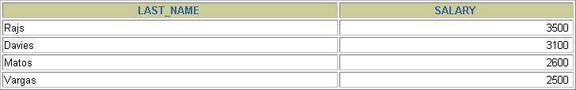
USING THE BETWEEN CONDITION
Use the BETWEEN condition to display rows based on a range of values.
SELECT last_name, salary
FROM employees
WHERE salary BETWEEN 2500 AND 3500;
Lower limit
Upper limit

Slide 12
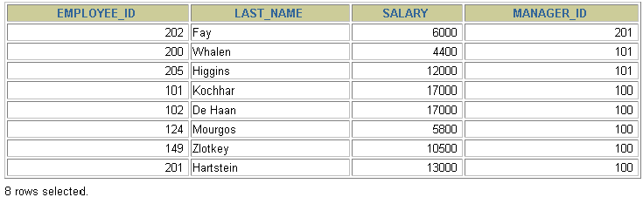
USING THE IN CONDITION
Use the IN membership condition to test for values in a list.
SELECT employee_id, last_name, salary, manager_id FROM employees
WHERE manager_id IN (100, 101, 201);

Slide 13
USING THE LIKE CONDITION
Use the LIKE condition to perform wildcard searches of valid search string values.
Search conditions can contain either literal characters or numbers:
  % denotes zero or many characters.
  _ denotes one character.
SELECT FROM WHERE
first_name employees
first_name LIKE 'S%';

Slide 14

USING THE LIKE CONDITION
You can combine pattern-matching characters.
SELECT last_name FROM employees
WHERE last_name LIKE '_o%';
You can use the ESCAPE identifier to search for the actual % and _ symbols.

Slide 15
USING THE NULL CONDITIONS
Test for nulls with the IS NULL operator.
SELECT last_name, manager_id FROM employees
WHERE manager_id IS NULL;

Slide 16
LOGICAL CONDITIONS
Operator | Meaning
AND | Returns TRUE if both component conditions are true
OR | Returns TRUE if either component condition is true
NOT | Returns TRUE if the following condition is false

Slide 17
AND requires both conditions to be true.
USING THE AND OPERATOR
SELECT employee_id, last_name, job_id, salary
FROM WHERE AND
employees salary >=10000
job_id LIKE '%MAN%';

Slide 18
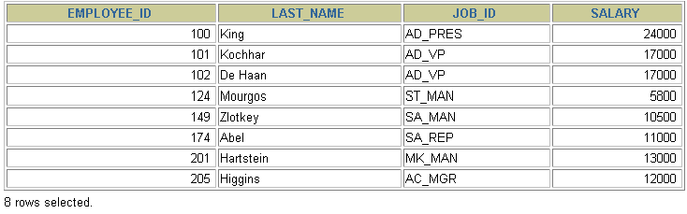
OR requires either conditions to be true.
USING THE OR OPERATOR
SELECT employee_id, last_name, job_id, salary
FROM employees WHERE
OR
salary >= 10000
job_id LIKE '%MAN%';

Slide 19
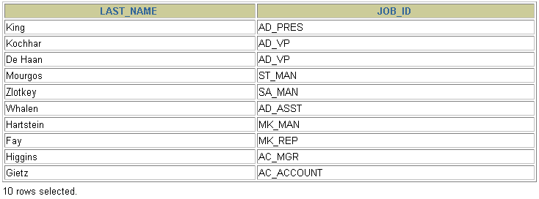
USING THE NOT OPERATOR
SELECT last_name, job_id FROM employees
WHERE job_id
NOT IN ('IT_PROG', 'ST_CLERK', 'SA_REP');

Slide 20
RULES OF PRECEDENCE
Order Evaluated | Operator
1 | Arithmetic operators
2 | Concatenation operator
3 | Comparison conditions
4 | IS [NOT] NULL, LIKE, [NOT] IN
5 | [NOT] BETWEEN
6 | NOT logical condition
7 | AND logical condition
8 | OR logical condition
Override rules of precedence by using parentheses.

Slide 21
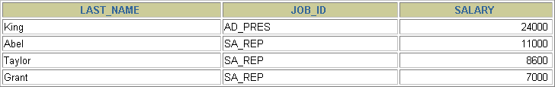
RULES OF PRECEDENCE
SELECT last_name, job_id, salary
FROM WHERE
employees
job_id = 'SA_REP' job_id = 'AD_PRES' salary > 15000;
OR
AND

Slide 22
Use parenthesis to force priority.
RULES OF PRECEDENCE
SELECT last_name, job_id, salary
FROM
WHERE
employees
(job_id = 'SA_REP' job_id = 'AD_PRES') salary > 15000;
OR
AND

Slide 23
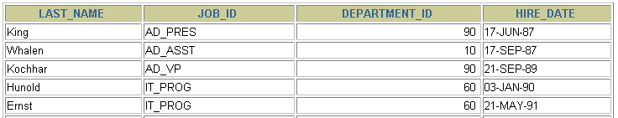
ORDER BY CLAUSE
Sort rows with the ORDER BY clause
  ASC: ascending order, default
  DESC: descending order
The ORDER BY clause comes last in the SELECT statement.
SELECT last_name, job_id, department_id, hire_date FROM employees
ORDER BY hire_date
;
…

Slide 24
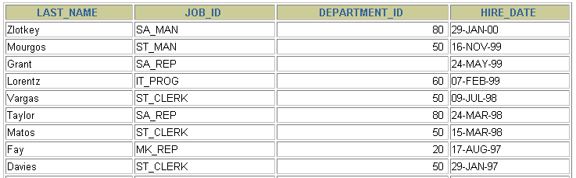
SELECT
SORTING IN DESCENDING ORDER
last_name, job_id, department_id, hire_date
FROM employees
ORDER BY hire_date
DESC
;
…

Slide 25
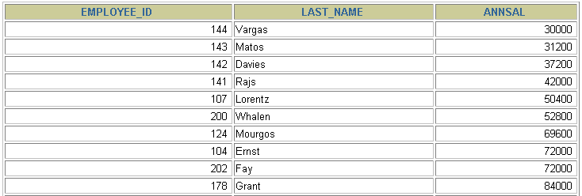
SELECT employee_id, last_name, salary*12 FROM employees
ORDER BY annsal;
SORTING BY COLUMN ALIAS
annsal
…

Slide 26
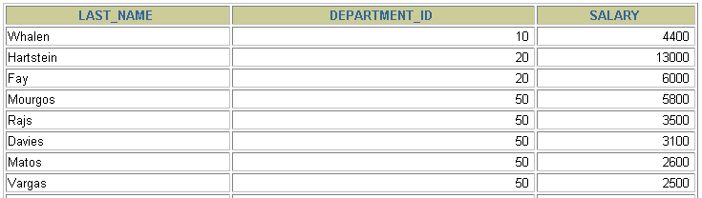
SORTING BY MULTIPLE COLUMNS
The order of ORDER BY list is the order of sort.
SELECT last_name, department_id, salary FROM employees
ORDER BY department_id, salary DESC;
…
You can sort by a column that is not in the SELECT list.

Slide 27
In this lesson, you should have learned how to:
SUMMARY
Use the WHERE clause to restrict rows of output
  Use the comparison conditions
  Use the BETWEEN, IN, LIKE, and NULL conditions
  Apply the logical AND, OR, and NOT operators
Use the ORDER BY clause to sort rows of output
SELECT FROM
*|{[DISTINCT] column|expression [alias],...}
table
[WHERE [ORDER BY
condition(s)]
{column, expr, alias} [ASC|DESC]];

